Slide 1
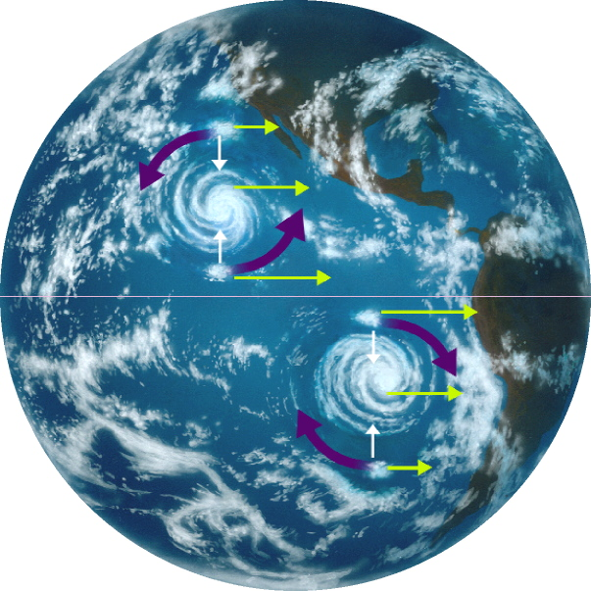
PHYSICS IN ROTATING COORDINATE SYSTEM
Notes:
Video of coriolis force

Slide 2
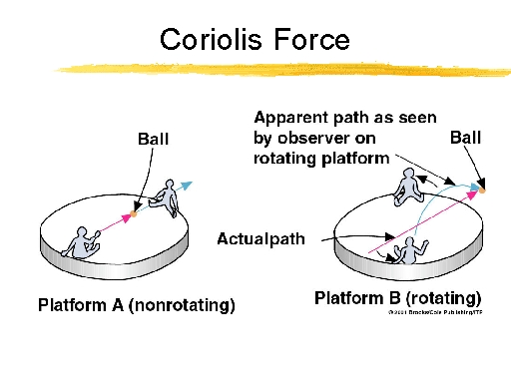
Coirolis Acceleration

Slide 3
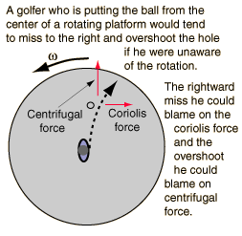
Blame Physics for your mistakes!

Slide 4

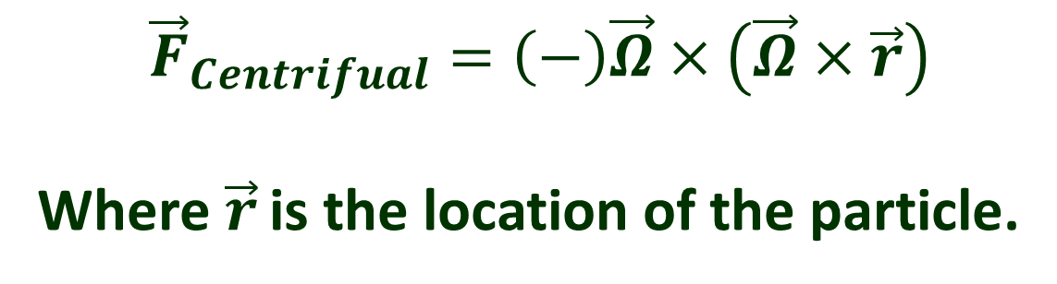
Some mathematical aspect of Fictitious force
$${\vec{F}}_{Coriolis}=\left(−\right)2m\vec{Ω}×{\vec{V}}_{radial}$$
$${\vec{F}}_{Centrifual}=\left(−\right)\vec{Ω}×\left(\vec{Ω}×\vec{r}\right)$$
Where$\vec{r}$ is the location of the particle.
Notes:
Talk about deflection of falling mass qualitatively, show hurricane video and apparent gravity. Coriolis force always produces acceleration along the tangential direction i.e along theta cap direction.

Slide 5
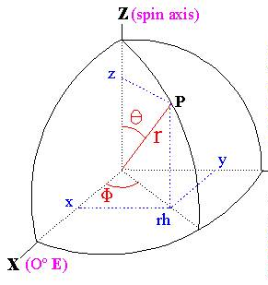
Coriolis force due to earth’s rotation
Local vertical
Local vertical

Slide 6
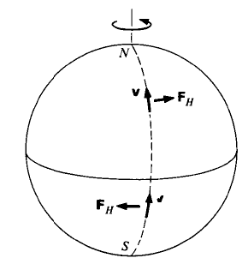
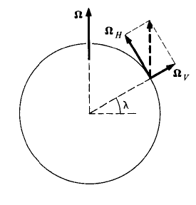
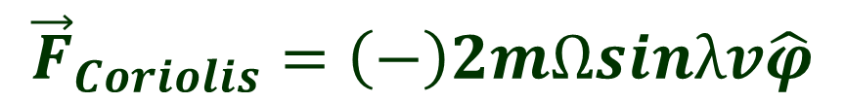

Coriolis force due to earth’s rotation
$${\vec{F}}_{Coriolis}=\left(−\right)2m\vec{Ω}×{\vec{V}}_{radial}$$
$${\vec{F}}_{Coriolis}=\left(−\right)2mΩsinλv\hat{φ}$$

Slide 7
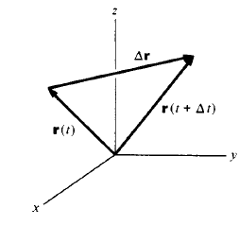
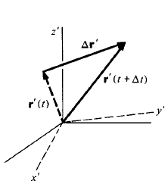
Velocity in Inertial and Rotating Frame

Slide 8
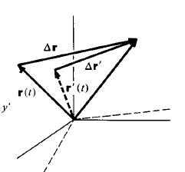
Velocity in Inertial and Rotating Frame
Velocity measured in rotating frame differs from the velocity measured in a stationary frame by pure rotation!

Slide 9
Velocity in Inertial and Rotating Frame
Coirolis Theorem
Velocity measured in the rotating frame
Apparent Velocity of the point of interest with respect to rotating frame
Notes:
In the text book r-r’ is given as positive which is not correct. Omega cross r should be minus. So our treatment here is valid.

Slide 10
Acceleration in Inertial and Rotating Frame
Notes:
Since signs simple means direction, we can neglect signs for the moment and focus on physics to be consistent with the text in the book. If we imagine the object to come towards us instead of moving away then our treatment becomes similar to Kleppener.
V rotation can be thought of as a motion of observer whose is sitting on the point p. When this point p is accelerating, then the person sitting at the point will experience both coriolis and centrifugal acceleration.

Slide 11
Acceleration in Inertial and Rotating Frame
Acceleration measured in
non-inertial frame
Centrifugal
Acceleration
Coriolis Acceleration

Slide 12
Coirolis Force Cont…Deflection of a falling mass
Before releasing
After releasing
R
O
O
θ
A
A
Deflection of Falling mass = Rθ

